Slide 1


Final Year Project
Chat With Quran
Supervised By: Muhammad Usman Karim (Lecturer)

Slide 2
Project Team
Haider Ali (29223)
Imdad Ullah(28556)
Faizan Qureshi (28582)

Slide 3
Table of Content
Background and Introduction
Literature Review
Problem Statement
Project Scope
Proposed Solution
Requirements Summary
Design Summary
Methodology
Implementation Summary
Experiments and Results Summary
Testing Summary
Conclusion and Outlook

Slide 4
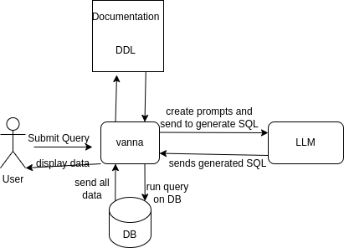
BACKGROUND AND INTRODUCTION
Submit query in natural language and retrieve in sql

Slide 5
Background and Introduction
Many people want to explore Quranic knowledge but lack the technical skills to query structured databases using SQL.
This project uses AI to allow users to ask questions in natural language and automatically translates them into SQL queries.
By combining tools like Vanna, ChromaDB, and LLMs, the system enables intelligent search and retrieval from a rich Quranic database.

Slide 6

Literature Review
Although there is extensive research in the field of chatbot for Quran, the next slide will highlight the studies that are particularly relevant to our project.

Slide 7
Title | Year | Key Focus | Limitations
Arabic Chatbots Challenges and Solutions | 2024 | To make chatbot intelligent using NLP techniques | Manual data collection limits dataset size and quality
Manual data collection limits dataset size and quality | 2024 | The project aimed to improve Quranic search by collecting and evaluating multiple data sources, testing various models (pre-trained and custom), and using techniques like cosine similarity and word2vec to find the best way to match Quranic text with user queries. | The main challenge was the lack of high-quality training data, which affected the accuracy of results, particularly with pre-trained models and topic modeling techniques. Despite some success with word2vec, the overall performance was limited by insufficient data.
From Natural Language to SQL: Review of LLM-based Text-to-SQL Systems | 2024 | It identifies key challenges such as linguistic ambiguity, complex SQL operations, schema understanding, and cross-domain generalization. | major limitations such as schema understanding, query complexity, and domain generalization

Slide 8

PROBLEM STATEMENT

Slide 9
Problem Statement
Traditional search methods for Quranic content are time consuming, require expertise, and are complicated by language differences, varied interpretations, and the need for theological accuracy.
Current methods of accessing Quranic information are inefficient and inaccessible to many. The complexity of searching across languages, varying interpretations, and ensuring theological accuracy makes it difficult for users to obtain timely, relevant, and trustworthy answers.

Slide 10

ENDEAVOUR

Slide 11
Endeavour
Describe roles of your team members
Describe your software development process
Describe your way of working as a team

Slide 12
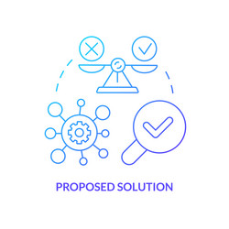
PROPOSED SOLUTION

Slide 13
Proposed Solution
Our solution focus on implement an AI-powered chatbot that allows users to ask natural language questions about the Quran. It uses the integrated components to ensure accurate, fast, and theologically sound responses:

Slide 14
Proposed Solution
Key Features:
Users can ask questions in plain English eliminating the need for SQL knowledge or technical skills.
The system uses ChromaDB and Vanna to retrieve relevant context and generate accurate, meaningful responses aligned with Islamic teachings.
Automatically translates user questions into SQL using LLMs, runs them on a structured Quranic database, and returns precise verse-level results.

Slide 15
Requirements Summary
ID | Requirements
FR-1.1 | The user should be able to submit query in natural language.
FR-1.2 | The system should Accurately conversion of questions into SQL queries
FR-1.3 | Context retrieval from vector database (ChromaDB)
FR-1.4 | The results should be with Quranic translations and tafsir
FR-1.5 | User-friendly interface for non-technical users

Slide 16
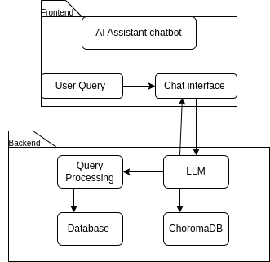
Design Summary

Slide 17
Methodology
Data Embedding & Storage
Quranic translations and tafsir are embedded using the TRAIN() function.
Stored data in ChromaDB for semantic search.
User Query Submission
Users ask questions in natural language via the Streamlit frontend.

Slide 18
Methodology
Context Retrieval & SQL Generation
Vanna retrieves relevant context from ChromaDB
Uses an LLM to generate accurate SQL queries.
Query Execution & Response Display
SQL is executed on the Quranic database.
Results (verses or tafseer and Translation) are shown to the user.

Slide 19
Implementation Summary
Data Integration
Imported Quranic translations and tafsir into a structured SQL database for efficient querying.
Embedding Generation with Vanna
Used TRAIN() to convert documentation, SQL samples, and schema into vector embeddings stored in ChromaDB.

Slide 20
Implementation Summary
Natural Language Query Handling
Developed a Streamlit interface for users to input questions in plain language
Contextual Search and SQL Generation
Vanna retrieves relevant embeddings and uses an LLM to generate SQL queries based on the user's question.

Slide 21
Experiments and Results Summary
Query Testing with Real-World Questions
Evaluated the system using various user queries related to Quranic topics (e.g., "What does the Quran say about forgiveness?").
Accuracy of SQL Generation
Most queries were correctly translated into SQL by the LLM with high accuracy, retrieving relevant verses and tafsir from the database.

Slide 22
Experiments and Results Summary
Contextual Relevance
ChromaDB effectively retrieved semantically related context, improving the accuracy of responses even when queries used different wording.
User Experience Feedback
Test users found the interface intuitive and the responses contextually appropriate and theologically accurate, enhancing understanding of Quranic content.

Slide 23
Testing Summary
Functional Testing
Verified that the chatbot correctly accepts user queries, generates appropriate SQL, and returns relevant Quranic verses or tafsir.
Accuracy & Relevance Testing
Tested with diverse natural language questions to ensure results matched the intent and Islamic context of the queries.

Slide 24
Testing Summary
Context Retrieval Validation
Evaluated ChromaDB’s ability to fetch meaningful semantic context (SQL samples, schema, and documentation) for accurate SQL generation.
User Interface Testing
Ensured the Streamlit frontend was responsive, user-friendly, and displayed results clearly without lag or confusion.

Slide 25

CONCLUSION AND OUTLOOK

Slide 26
Conclusion & Outlook
The AI-powered Quran Assistant chatbot effectively bridges the gap between users and Quranic knowledge by enabling natural language queries and delivering accurate, context-aware responses. By integrating Vanna, ChromaDB, and LLMs.
Challenges :
Handling queries with diverse wording and meaning while maintaining relevance and semantic accuracy.

Slide 27
Conclusion & Outlook
Future Scope: Expand the system to support Arabic, Urdu, and other regional languages to reach a broader audience.
Enable speech-to-text functionality so users can ask questions through voice commands.
Broaden the knowledge base to include Hadith collections and Islamic jurisprudence (Fiqh).

Slide 28
Conclusion & Outlook
Thank you for your time and attention.
I look forward to your questions and feedback on this meaningful project.

